Slide 1



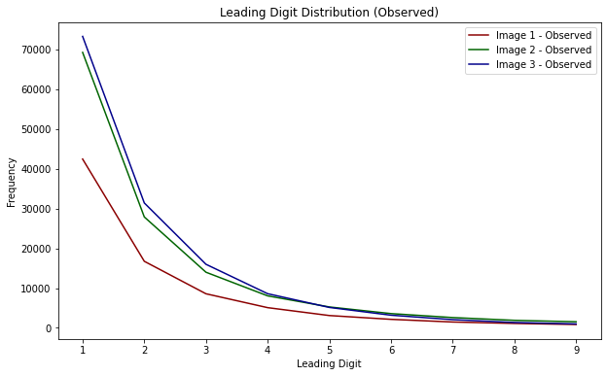
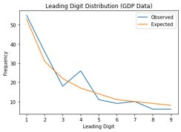
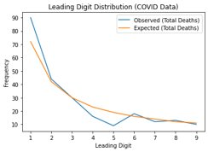
Benford's Law of Probability
The Secret Life of Numbers
338
@DigitalSreeni

Slide 2
What in the world is Benford's Law?
Benford's Law states that in a vast array of datasets, the first digits from 1 to 9 do not occur with equal frequency.
Instead, smaller digits like 1 appear more often as first digits, while larger digits like 9 appear less frequently.
When data is distributed across multiple orders of magnitude, there are more numbers with smaller first digits (1, 2, 3) than larger ones (8, 9).
This distribution occurs naturally in processes like population growth, financial transactions, and scientific measurements.

Slide 3
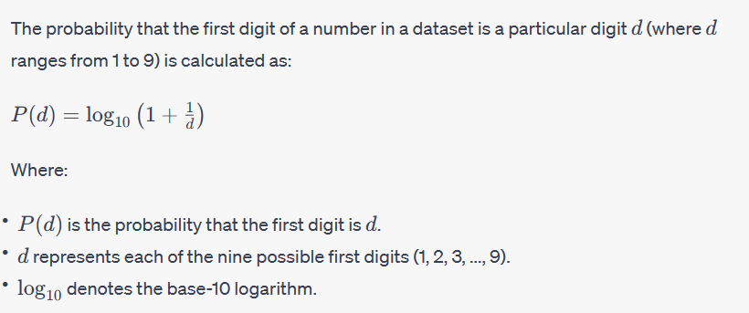
prob = log10(1 + 1/digit)
Let us verify Benford’s law on a few datasets using python
(of course, including image data)

